Slide 1
Statistical modelling with python
Niki Yaw

Slide 2
WHAT I DID (1/2)
1. Data exploration with the data obtained from all 3 APIs.
2. Decide on the target variables:
- dependent variable: total bike slots
- independent variable: number of cafes around all the bike stations
3. Data cleaning
- decide what to do with the Null values
- list with no objects

Slide 3
WHAT I DID (2/2)
4. Hypothesis testing
- Shapiro-Wilk test for Normal Distribution (totalBikeSlots)
- Pearson’s Correlation Coefficient (bike slots vs. number of cafes)
- T-test (compare results from Foursquare & Yelp)
5. Model building: 2 linear regression models
- bike slots vs. number of cafes from Foursquare
- bike slots vs. number of cafes from Yelp

Slide 4
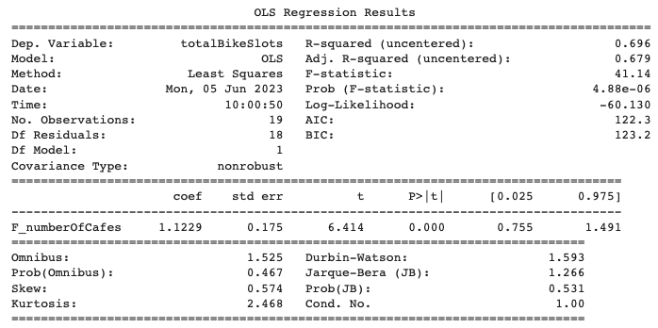
RESULTS (bike slots vs number of cafes – F)
R-squared = 0.696
- shows that this model explains only 69.6% of the patterns in the data
P-value = 0
F_numberOfCafes does impact totalBikeSlots
Coefficient = 1.1229
- shows that the increase of F_numberOfCafes will have a positive impact on the totalBikeSlots

Slide 5
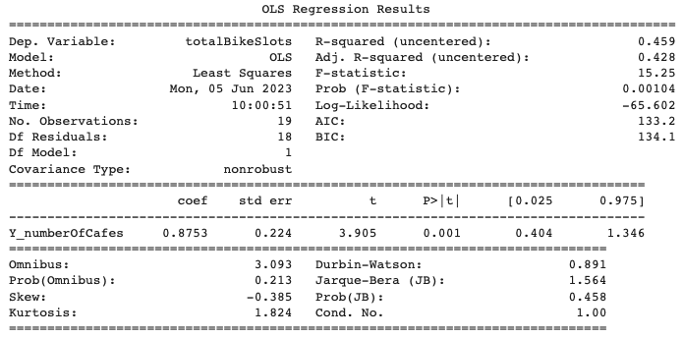
RESULTS (bike slots vs number of cafes – Y)
R-squared = 0.459
- shows that this model explains only 45.9% of the patterns in the data
P-value = 0.001
F_numberOfCafes does impact totalBikeSlots
Coefficient = 0.8753
- shows that the increase of F_numberOfCafes will have a positive impact on the totalBikeSlots

Slide 6
Biggest challenges
1. Small sample size
2. Data is limited (too many null values)
- initial interested variables: number for cafes & ratings of those cafes
- lack of data from Foursquare (a lot of cafes do not have ratings)
- not to make any assumptions on the null values, variable was dropped at the end

